Slide 1
Classification Boundaries
By Aradhya Chouhan

Slide 2
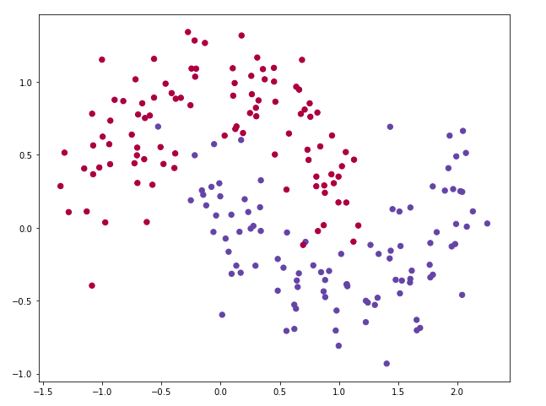
The dataset.
We use sklearn.make_moons dataset builder from scikit-learn. It is a simple toy dataset to visualize clustering and classification algorithms.

Slide 3
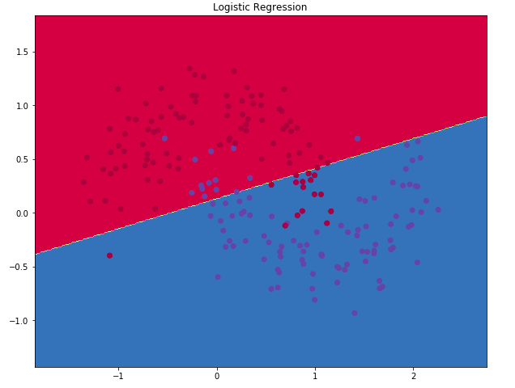
Logistic Regression

Slide 4
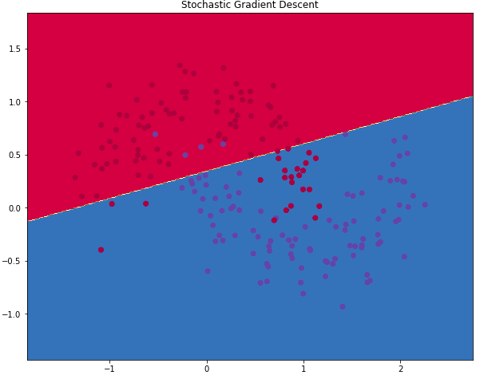
Stochastic Gradient Descent with Hinge Loss

Slide 5
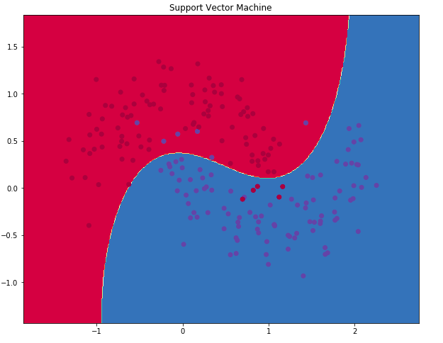
Support Vector Classifier with RBF kernel

Slide 6
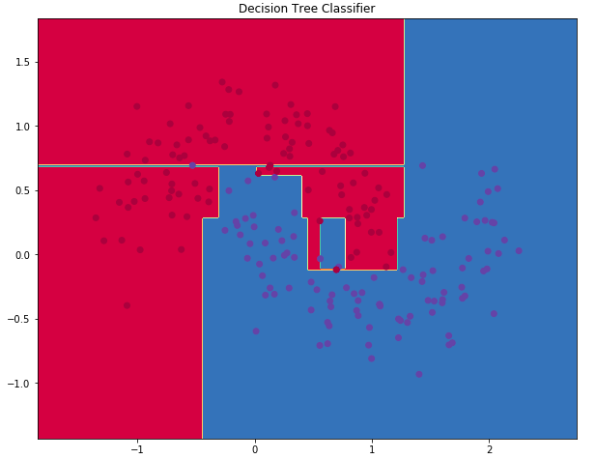
Decision Tree using GINI Index

Slide 7
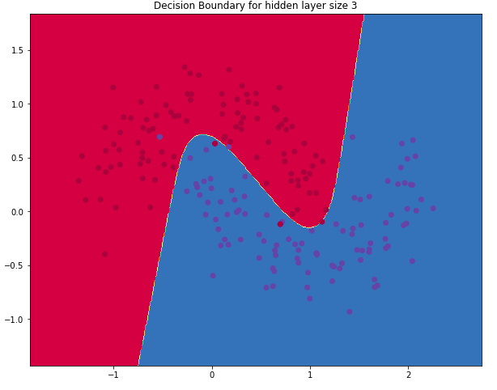
Single layer Neural Network of hidden layer of 3

Slide 8
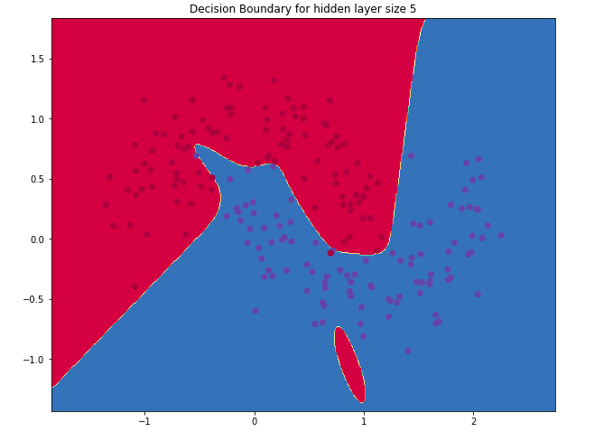
Single layer Neural Network of hidden layer of 5

Slide 9
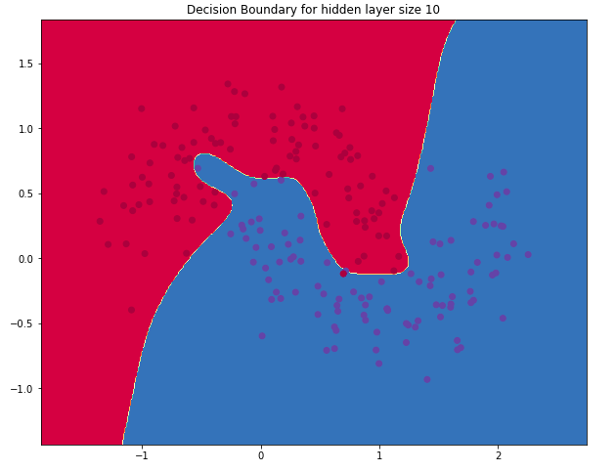
Single layer Neural Network of hidden layer of 10

Slide 10
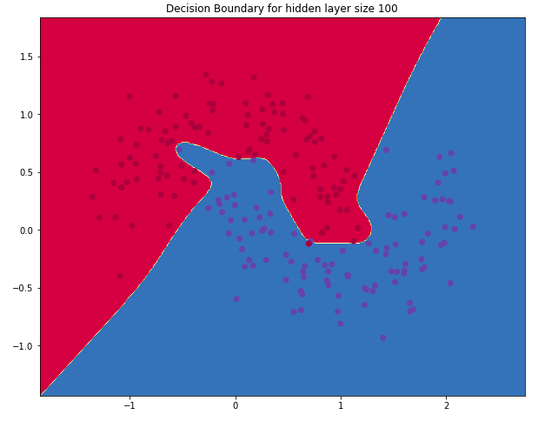
Single layer Neural Network of hidden layer of 100

